Slide 1


Data Mining and Machine Learning
Project : Real or Not? NLP with Disaster Tweets
HEC Lausanne

Slide 2
Project description

Slide 3
Project description
Goal
data set
Github
submissions

Slide 4


Slide 5


Slide 6
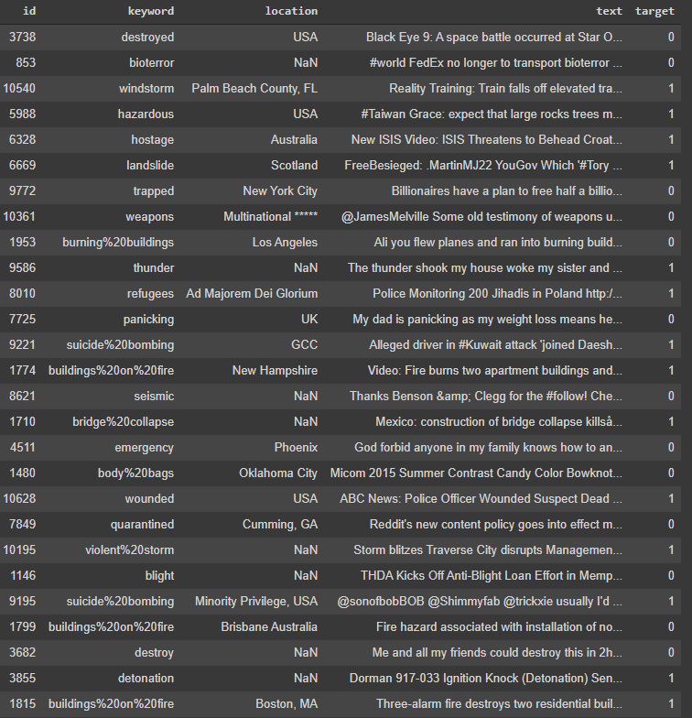
Data set
6471 rows
5 columns
id
keyword
location
text
target

Slide 7


Slide 8
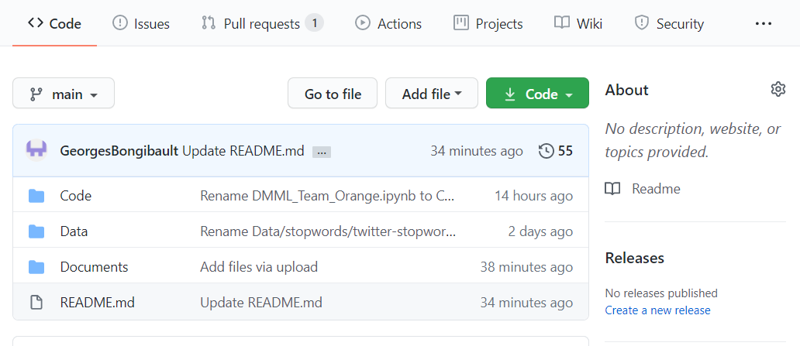
GitHub

Slide 9


Slide 10
Submissions
Date | Model | Validation Accuracy | Submission accuracy
22/11/2020 | basic logistic regression | 0,8108
22/11/2020 | basic logistic regression CV | 0,8154 | 0,819
28/11/2020 | logistic regression without duplicates | 0,8013 | 0,806
28/11/2020 | logistic regression with base rate = 0,5 | 0,7798 | 0,8
28/11/2020 | basic randomforest classifier with optimized tf-idf | 0,7737 | 0,792
05/12/2020 | basic logistic regression with optimized tf-idf | 0,8178 | 0,799
05/12/2020 | optimized logistic regression with optimized tf-idf | 0,8178 | 0,806
06/12/2020 | optimized randomforest with optimized tf-idf | 0,79 | 0,776
07/12/2020 | basic KNN | 0,778 | 0,72
08/12/2020 | Optimized KNN | 0,783 | 0,781
12/12/2020 | PCA (reduce to 1000 features) on optimized tfidf + logistic regression | 0,8015
12/12/2020 | Feature engineering | 0,8131
13/12/2020 | stopwords | 0,8178
13/12/2020 | nltk | 0,8178
13/12/2020 | Word2Vec | 0,81

Slide 11
Work week by week
Week 1 :
Discovered the project
Created Repository with test and training data
Created a Slack channel for discussion
Started the notebook, computed the base rate (57%) on 6471 samples in the training data
Week 2 :
Ran basic prediction with 0.8 accuracy on our test part of the training data
Submitted and got 0.819 test accuracy
Did the EDA : top keywords and locations, top keywords and locations with the most real and fake tweets
Delete doubling, usernames and hashtags and see a slight decrease in accuracy (0.8003)

Slide 12
Week 3 :
Week 4 :
Week 5 :
optimizing the hyperparameters of logistic regression, tf-idf and random forest
pooling of our codes
testing of vectorizer configs
testing of the RandomForest, with no improvement for the moment
testing KNN, with still no improvement from logistic regression for the moment
searched for stopwords and slangs lists
None of our submissions were better than the first one
testing new stopwords
reorganisation and presentation of the code
testing dimension reduction and features engineering
testing NLTK and Doc2Wword instead of TF-IDF
creation of the support for the presentation

Slide 13
Notebook’s Organisation

Slide 14
Notebook’s Organisation
Exploratory Data Analysis
First classifier: Logistic Regression
First ideas for improving accuracy
Second classifier: Random forest
Third classifier: K-Nearest Neighbours
Dimension Reduction and Feature Engineering
Further improvements

Slide 15
Exploratory Data Analysis

Slide 16
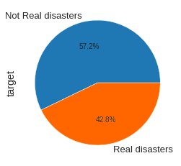
Base rate
Base rate : 0.5719
Most common class : the false disasters (3701 occurrences)

Slide 17
Variables description
“Keyword” :
count : 6416/6471
unique : 221
top : “deluge”
frequency : 39
“Location” :
count : 4330/6471
unique : 2921
top : USA
frequency : 91

Slide 18
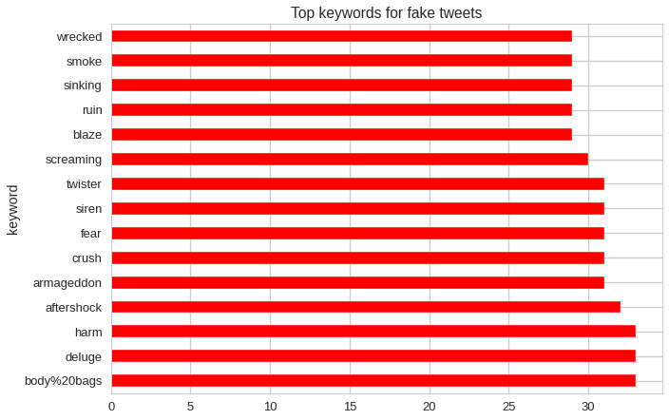
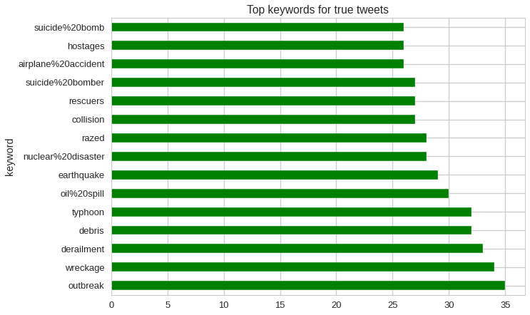
Keyword

Slide 19
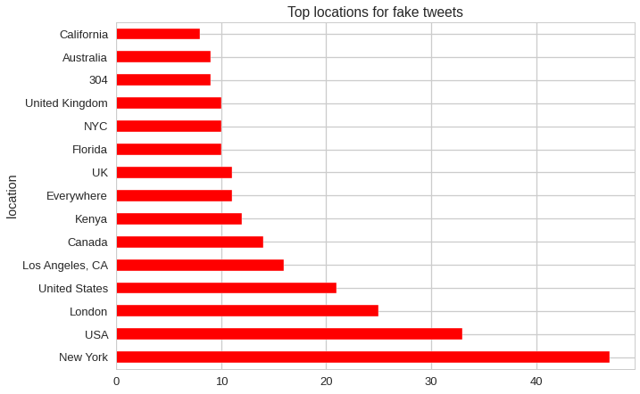
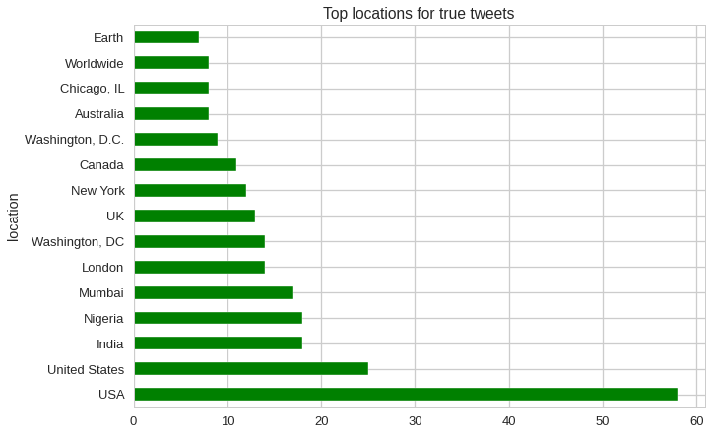
Location

Slide 20
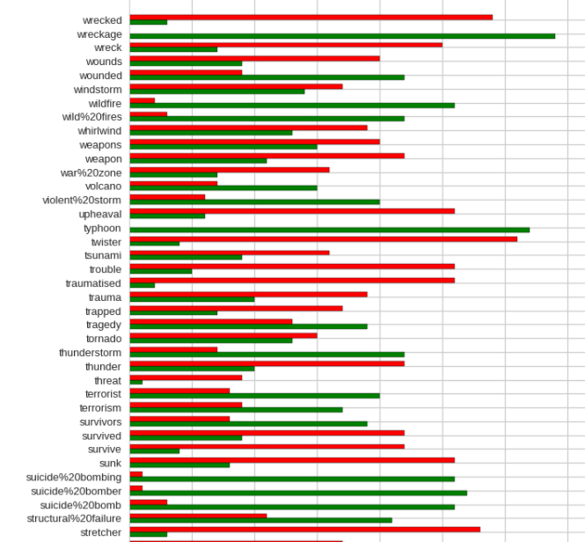
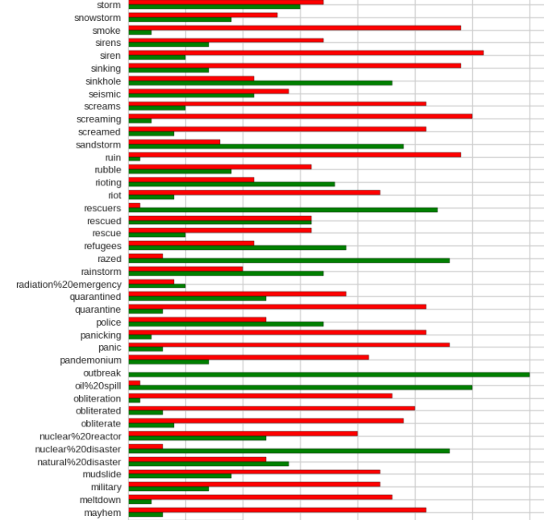
Validity of tweets by keywords

Slide 21
Variables description
“id” :
count : 6471/6471
unique : all
“text” :
count : 6471/6471
unique : 6387
frequency of the top occurrence : 9

Slide 22
First Classifier : Logistic Regression

Slide 23
Logistic Regression
Creation of a function to evaluate our models
We preprocessed the tweets with a spacy tokenizer
Train a LRegression with TF-IDF without cross-validation
Train a LRegression with TF-IDF with cross-validation
Best Accuracy : 0,8154 (TF-IDF with cross validation)

Slide 24
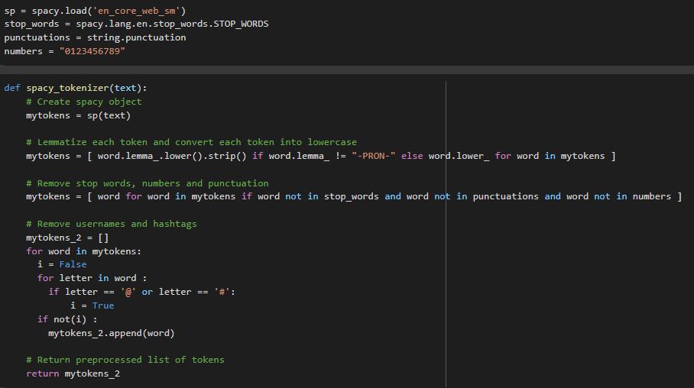
Spacy Tokenizer

Slide 25
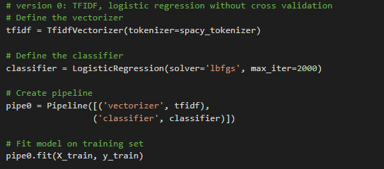
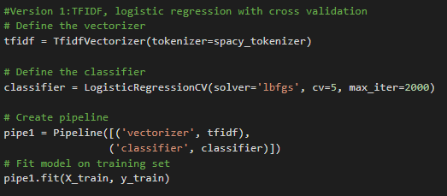
TF-IDF

Slide 26
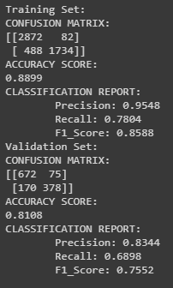
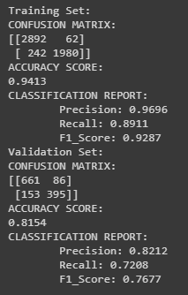
TF-IDF

Slide 27
First ideas for improving accuracy

Slide 28
Improving Accuracy
Removal of duplicated tweets
Accuracy decreases
Creation of a balanced data frame
Accuracy decreases sharply
Improve the TF-IDF Vectorizer
Optimize the parameters of the Logistic Regression
Accuracy increase to 0,8178
Tuning LRegression hyper parameters with GridSearchCV
Best Accuracy : 0,8178

Slide 29
Second Classifier : Random Forest

Slide 30
Random Forest
With the default parameters :
High Accuracy for the train set
Low Accuracy for the test set →Overfitted model
We try to optimize this method :
Find the best config
Best Accuracy : 0,7900 worse than LRegression

Slide 31
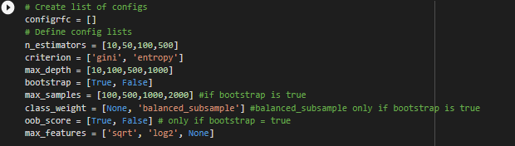
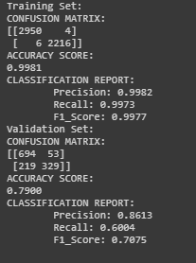
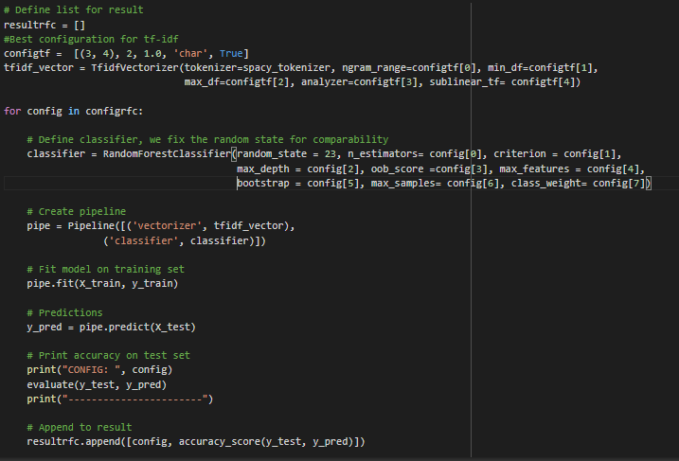

Slide 32
Third Classifier : K-Nearest Neighbours

Slide 33
K-Nearest Neighbours
With 5 neighbours :
Accuracy of 0,77
We try to optimize this method :
Find the best config
Best number of neighbours and best weight
GridSearch find the same parameters
Best Accuracy : 0,7830 worse than opti-Lregression
With 4 neighbours and weights uniform

Slide 34
Dimension Reduction and Feature Engineering

Slide 35
Dimension Reduction and Feature Engineering
Dimension Reduction :
Some of features of the TF-IDF vector may be correlated
Reduce the feature space with PCA (1000)
→Accuracy decrease
Feature Engineering :
Concatenate keywords to text to predict the veracity of tweets
Replace ‘%20’ by a simple space
Replace missing values
Best Accuracy : 0,8131 worse than opti-Lregression

Slide 36
Further Improvements

Slide 37
Further Improvements
Try others stopwords
Accuracy is the same than for the opti-Lregression
→spacy stopwords are probably similar
Test other tokenizer : NLTK tokenizer
We only test with the LR and the accuracy is the same (0.8095, after dropping duplicates)
Test other vectorizer : Doc2Vec (vectorizer)
Better result (0.8126) with NLTK WordNet Lemmatizer, remove digits, punctuation, stopwords, Without removing duplicates (0.7969) Vector size: tried different parameters

Slide 38
Conclusion

